Slide 1

Master’s Thesis
Influence of the Ignition Energy on the rate of pressure rise of hybrid dust-gas mixtures
Onuoha Prince Chiemela
Matric No.:221363

Slide 2
Introduction
Safety in process technology is of high importance as explosions in process facilities may result in serious consequences to human life, properties and the environment.
In process industries, not only dust, gas and vapor are present, but also more complex mixtures, such as mixtures of two or more materials of different state of aggregates.
The study of hybrid mixtures is very important as it has been shown in literature that the addition of gas significantly increases the violence of dust explosions and the ignition sensitivity of combustible dusts.

Slide 3
Aim and Objectives
This work aims to undertake an extensive investigation of the explosion phenomena of hybrid mixtures. This was accomplished by performing experiments to obtain safety characteristic data related to the severity of an explosion. The data from this work can help suggest a suitable ignition source and a mixture preparation procedure for a potential hybrid mixture standard.
Tasks
Mixture preparation.
Influence of turbulence on the rate of pressure rise and explosion overpressure of methane-air mixture.
Influence of the ignition energy and type on the rate of pressure rise of methane, cornstarch and methane-cornstarch air mixture.

Slide 4
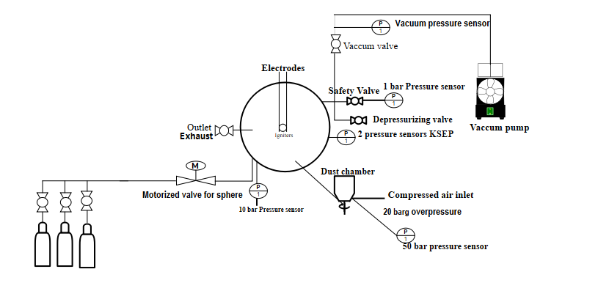
Experimental Setup
Experimental setup when the mixture was prepared directly in the 20-L sphere
13
12
11

Slide 5
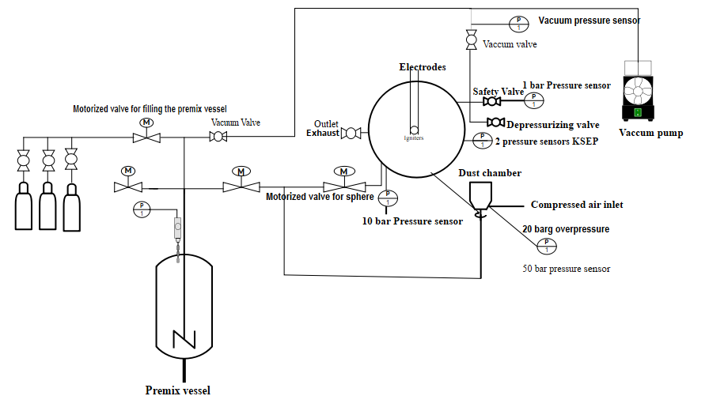
Experimental Setup
Experimental set up when the mixture was prepared using a premix vessel
13
12
11

Slide 6
Test Procedure
Prior to each experiment, using a vacuum pump, the sphere is evacuated first to a pressure less than 5 mbar.
When using the premix vessel, methane and air are filled according to the partial pressure method to a pressure of 30 bar before being separated directly into the sphere and the dust chamber.
Then the test mixture (air or methane and air) is added up to 400 mbar.
By triggering the ignition source with the KSEP software, the pneumatic valve is opened, and the dust is blown into the sphere with a defined overpressure of about 20 barg.
The ignition energies used in this work range from 20 J to 2000 J. Either two pyrotechnical igniters or two exploding wire igniters are used for the testing.

Slide 7
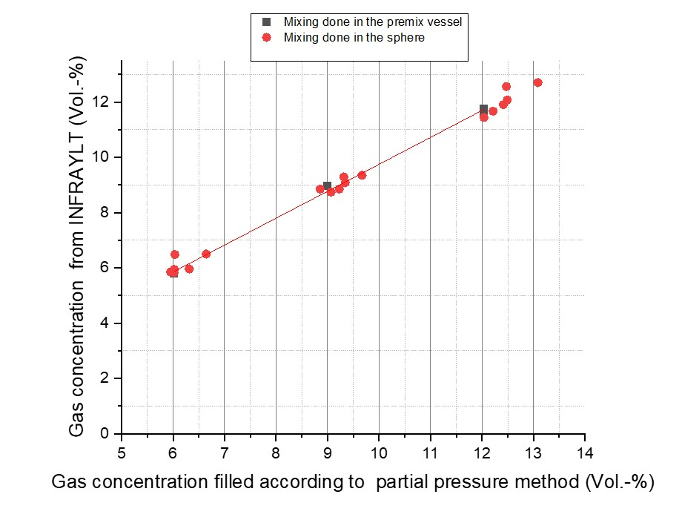
Gas Analytic
This was done using an extractive gas analyzer. The test gas for this procedure was CO2. A linear fit line helps to show the scatter obtained when both mixture preparation methods are used.
Systematic + Statistical deviation. Maximum deviation observed was about 0.15
It is possible to evaluate the accuracy of the mixture preparation. A trend of being under the desired concentration was observed. We were always a little under the desired concentrations of 6, 9 and 12% with a maximum deviation of 0.15 and this observation prompted the use of concentrations of 5.8, 8.8 and 11.8%.

Slide 8
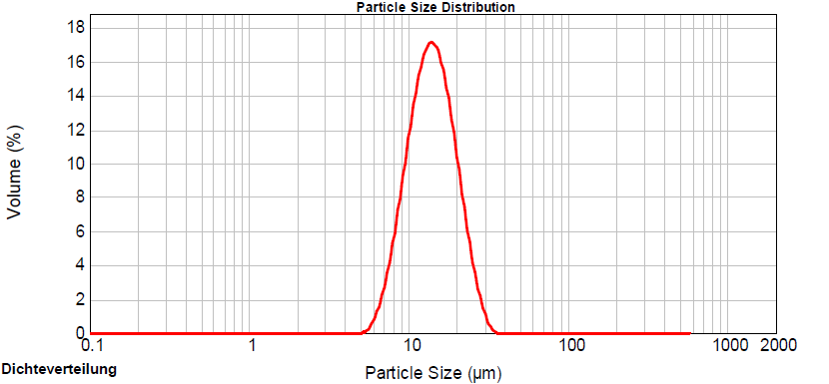
Particle size distribution
The particle size distribution of cornstarch is reported on an equivalent spherical diameter volume basis
According to the dust standards, The particle size of dust is 500 micro meter or less.
As seen in the distribution, the cornstarch has a median particle size of 15 micro metre.
This corresponds to the principle of dust testing in the 20-L sphere that states that the dust sample should have a median particle size not exceeding 63 micro metre.

Slide 9
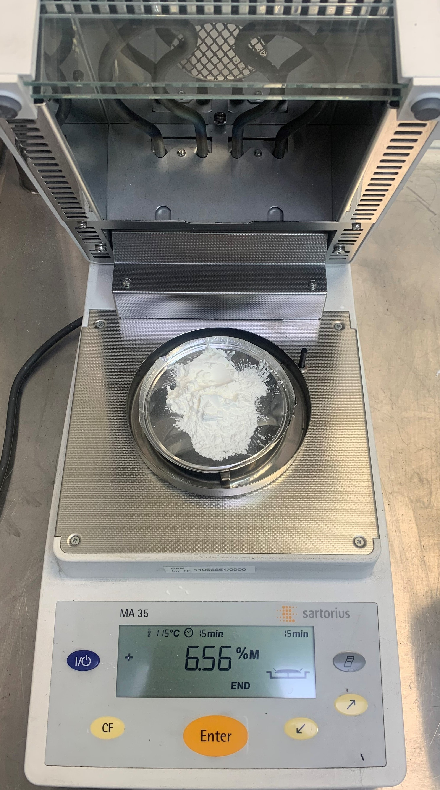
Dust Characterization
The moisture content was determined using a thermogravimetric moisture analyser on a weekly basis from 03.09.2020 to 06.10.2020.
Week | Weight | Moisture content
1 | 5.4 g | 6.57 %
2 | 7.5 g | 6.28 %
3 | 7.9 g | 6.52 %
4 | 8.5 g | 5.78 %
5 | 8.0 g | 7.08 %
6 | 8.6 g | 6.41 %
It was concluded that the test sample did not absorb moisture during the test series which could have biased the results. The slight differences observed are attributed to the impact of relative humidity.

Slide 10
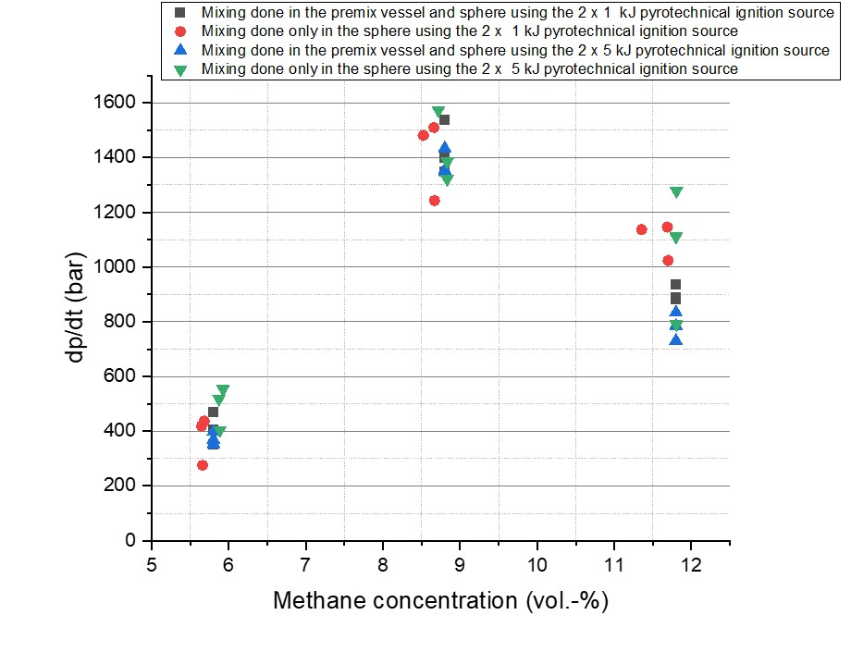
Ignition test result using a premix vessel.
The results from the ignition tests using a premix vessel were compared to tests where the mixture preparation was conducted in the sphere
The ignition tests showed that when mixture preparation is conducted directly in the sphere, the turbulence created within 60 ms allows for a sufficient level of homogeneity of the test mixture which does not influence the safety characteristic data. At a concentration of 11.8%, the reproducibility is lower and is attributed to being outside the explosible region. It should be noted that the ignition energy had no effect on the dp/dt.

Slide 11
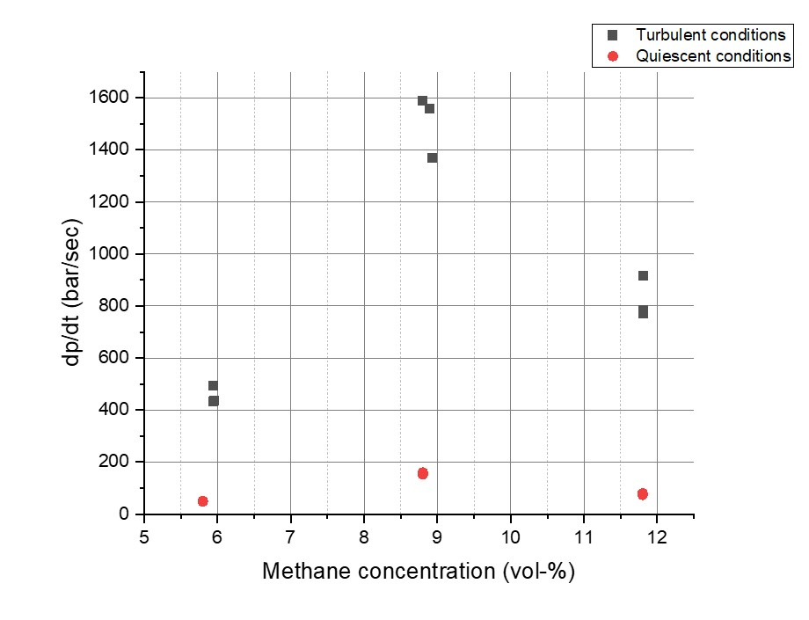
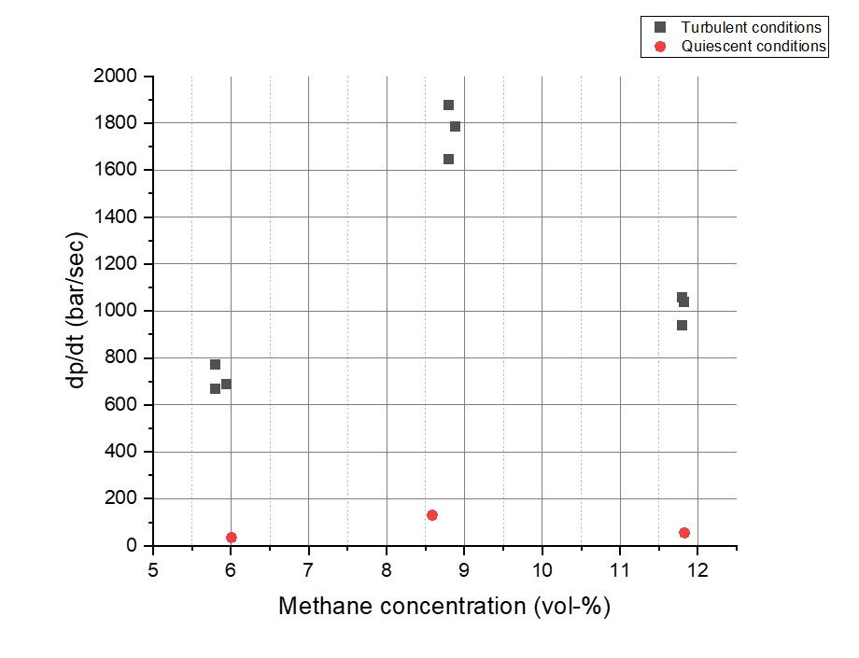
Effect of turbulence on the rate of pressure rise
The rate of pressure rise of methane-air mixture was observed under turbulent and quiescent conditions using an ignition energy of 2 x 1 kJ
2 x 1 kJ pyrotechnical Igniter
2 x 1 kJ exploding wire Igniter
The results obtained from the exploding wire and pyrotechnical igniter do not indicate any significant difference. Turbulence makes a great difference when gas mixtures are tested.
The tolerance given in the standard for dust clouds for the opening of the fast-acting valve and for the activation of the igniting device should be adjusted for a potential hybrid mixture standard as this maybe too high for gases, leading to a possible deviation.

Slide 12
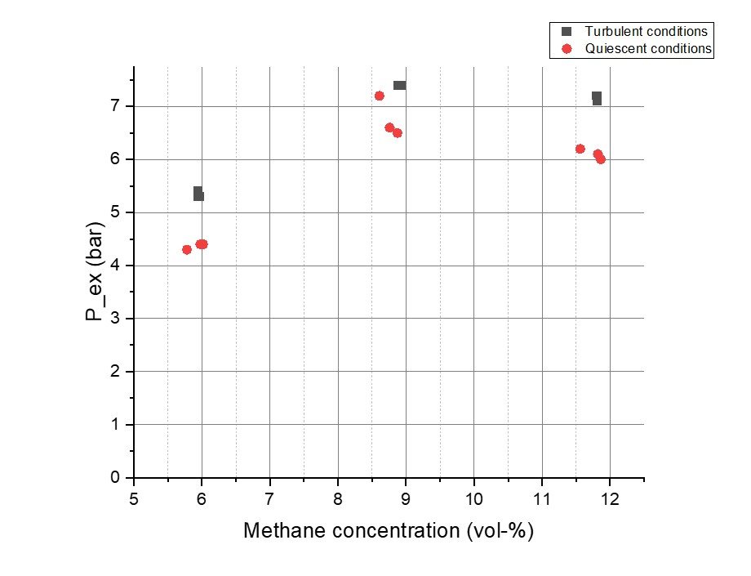
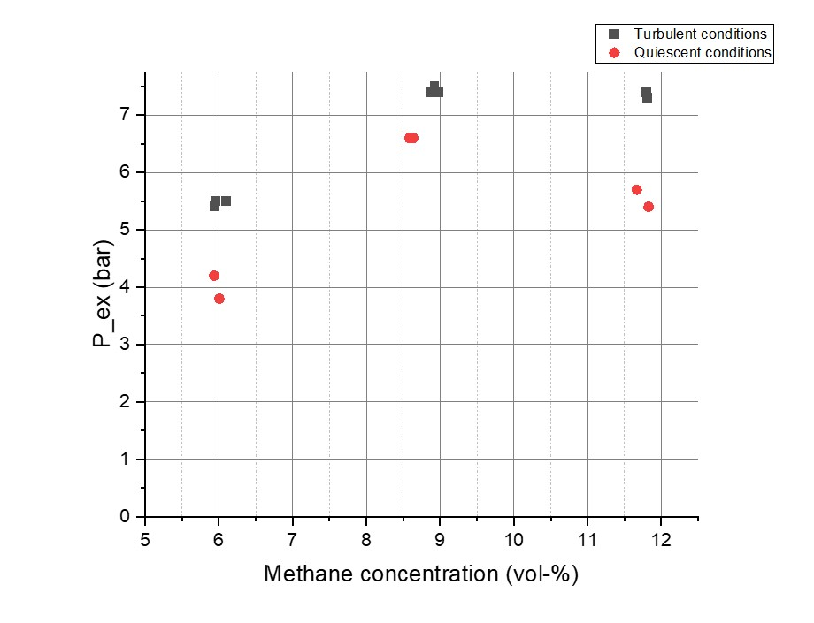
Effect of turbulence on the explosion overpressure
The explosion overpressure of methane-air mixture was observed under turbulent and quiescent conditions using an ignition energy of 2 x 1 kJ
2 x 1 kJ pyrotechnical Igniter
2 x 1 kJ exploding wire Igniter
The explosion overpressure is affected by turbulence. More heat dissipation occurs when the mixture is prepared under quiescent conditions while for turbulent test conditions, the whole reaction is faster and less heat loss is experienced. Also, elevated initial pressure as a result of compressed air is another reason why turbulence has an effect on explosion overpressure.

Slide 13
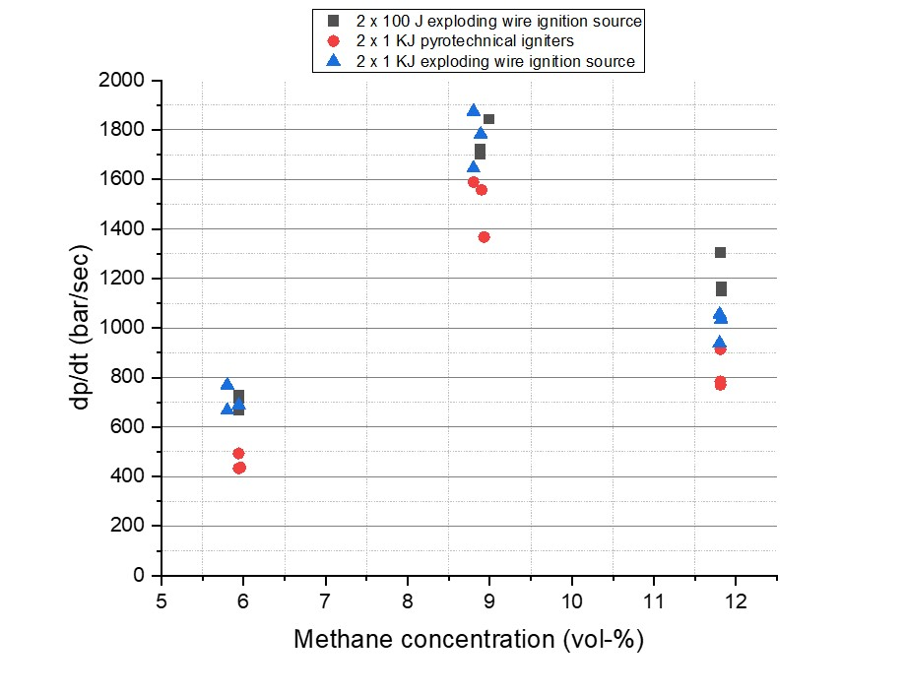
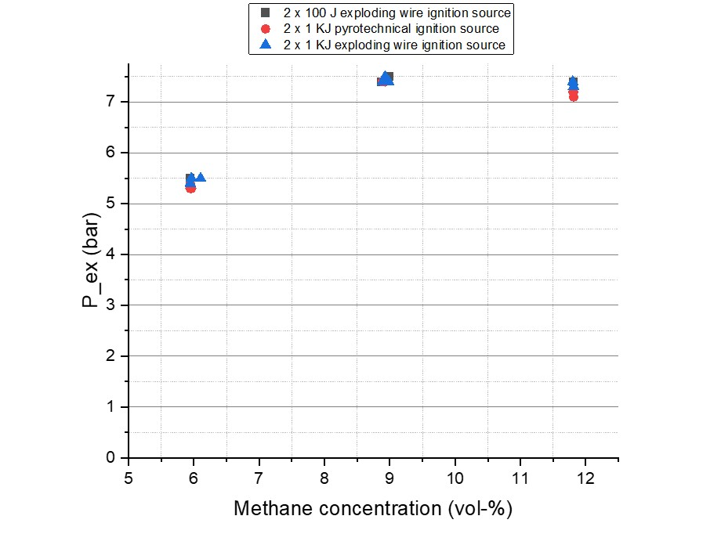
Influence of the ignition energy and type on the rate of pressure rise and explosion overpressure of methane
Methane-air mixtures are tested under turbulent conditions to observe the influence of the ignition energy on the rate of pressure rise and the explosion overpressure
A statistical deviation is observed in the rate of pressure rise as it is expected that the values from the pyrotechnical igniter should be higher since it is known that they can overdrive an explosion by adding more turbulence in the system due to its explosion speed.

Slide 14
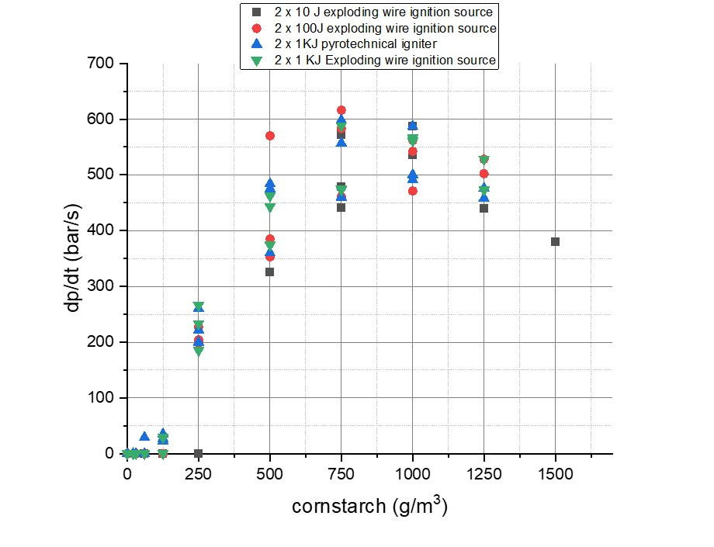
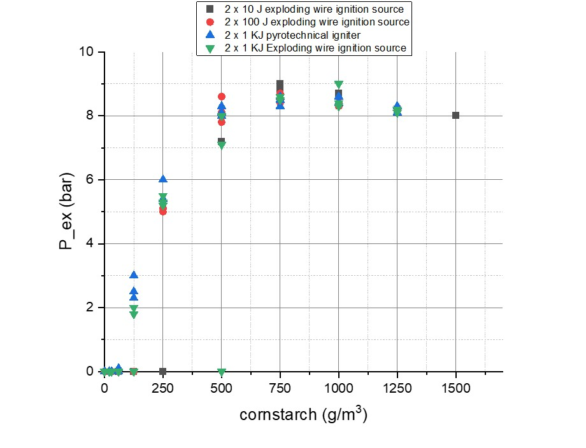
Influence of the ignition energy and type on the rate of pressure rise and explosion overpressure of cornstarch
Cornstarch-air testing is carried out under turbulent conditions
The higher ignition energy of 2 x 1 kJ was able to cause explosions at lower dust concentrations. With increasing ignition energies, the explosion region is widened, hence making the minimum explosible dust concentration smaller. The scattering effect seen at a dust concentration of 500 g/m3 is a a statistical and not a systematic scattering because the highest dp/dt values is obtained with an ignition energy of 2 x 100 J. It is also observed that the ignition energy does not significantly affect the highest point of explosion overpressure.

Slide 15
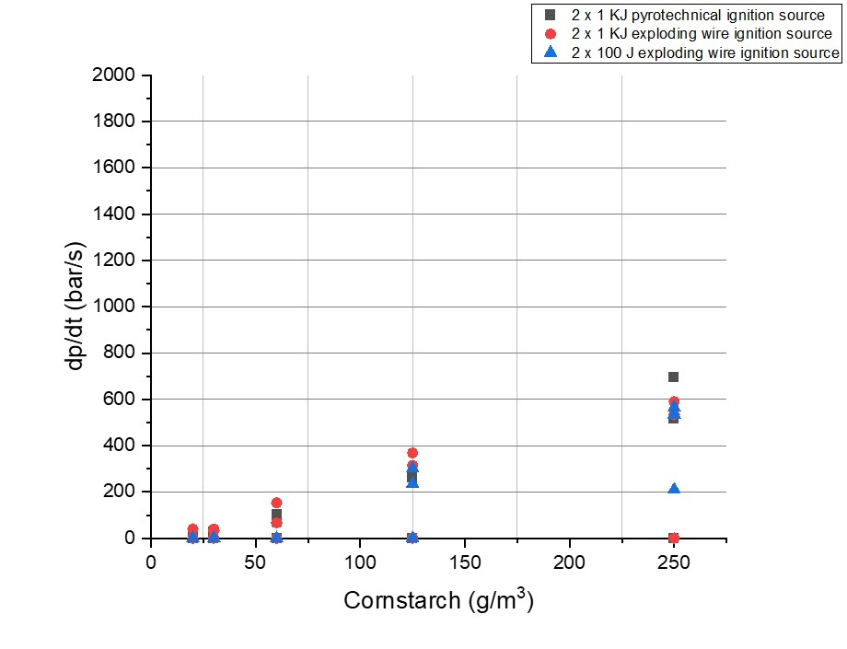
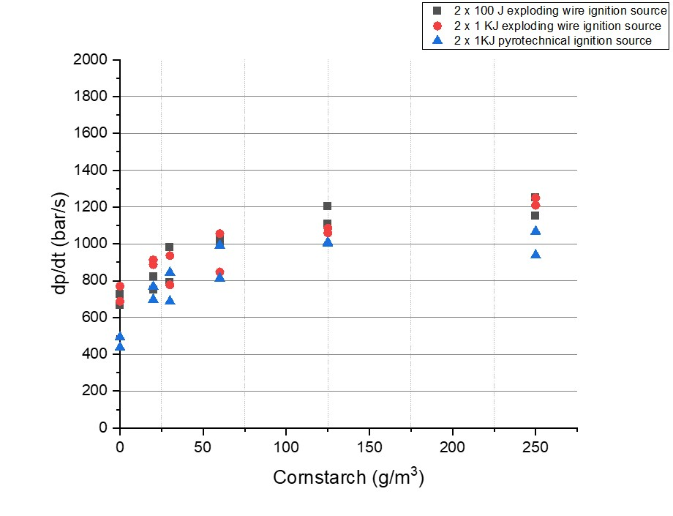
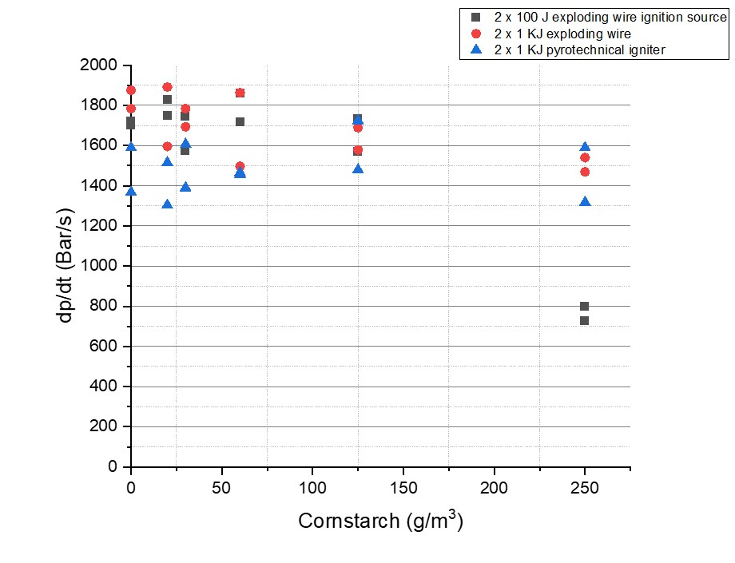
Influence of the ignition energy on the rate of pressure rise of the hybrid mixture
The explosion behavior of methane-cornstarch in air was investigated under turbulent conditions. The concentrations of methane chosen were 3, 6 and 9 %.
3 % methane
6 % methane
9 % methane
By adding 3 % of methane, it was observed that with higher ignition energies, a significant dp/dt is gotten. The ignition energy affects the rate of pressure rise at lower dust concentrations and concentrations of gas under its lower explosible limit.

Slide 16
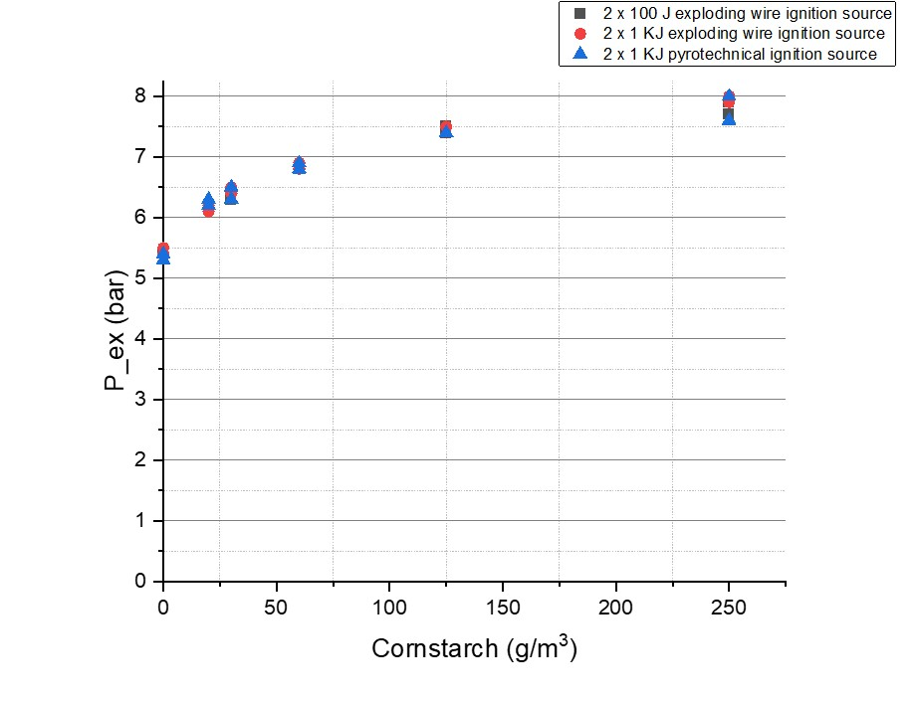
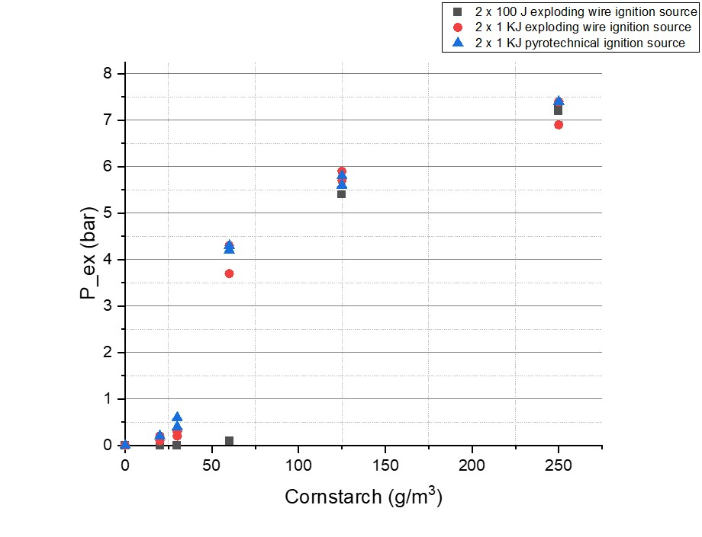
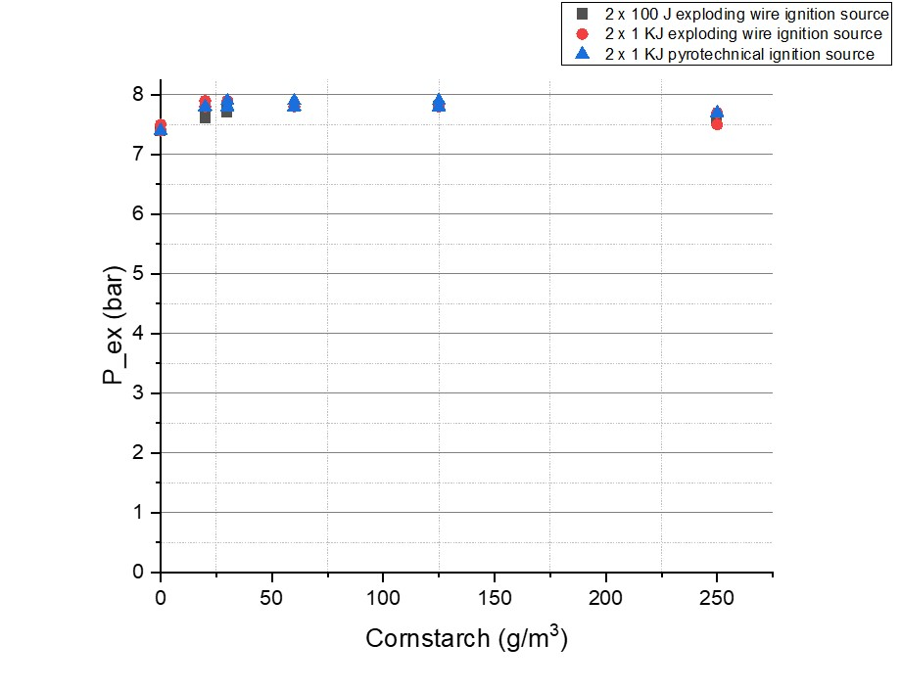
Influence of the ignition energy on the explosion overpressure of the hybrid mixture
The explosion behavior of methane-cornstarch in air was investigated under turbulent conditions. The concentrations of methane chosen were 3, 6 and 9 %.
6 % methane
3 % methane
9 % methane
The maximum explosion pressure observed from the hybrid mixture explosion were higher than those observed from the methane-air explosion. The ignition energy affects the explosion overpressure at lower dust concentrations and concentrations of gas under its lower explosible limit.

Slide 17
Conclusion
The modified 20-L sphere can be used as an explosion vessel to investigate the explosion characteristics of hybrid mixtures, yielding results with sufficient accuracy.
The use of the new ignition device for generating lightning arcs with defined ignition energy is sufficient for the determination of safety characteristics of hybrid dust-gas mixtures.
Conducting gas analytic validates the accuracy of the preparation of the mixture in the sphere.
Mixing directly in the 20-L sphere delivers sufficient homogenization of the test mixture within the mixing time of 60 ms. As a suggestion for a potential hybrid mixture standard, it is not necessary to use a premix vessel as this maybe time consuming.

Slide 18
Conclusion
The influence of turbulence on the rate of pressure rise of gases is huge and the tolerance for the ignition delay time in a potential hybrid mixture standard must be as low as possible.
The influence of the ignition energy on the maximum rate of pressure rise is very low. There is no significant additional turbulence that can influence the result as a result of the ignition energy. It is possible to use low ignition energies if the MIE of the test sample is low enough.
The ignition source has no influence on the safety characteristic data showing hat pyrotechnical igniters can be substituted by exploding wire igniters.
The ignition energy affects the rate of pressure rise and explosion overpressure of hybrid mixtures at lower dust concentrations and concentrations of gas under its lower explosible limit.

Slide 19
Future work
Experimental testing showing the influence of the ignition energy on the rate of pressure rise of hybrid mixtures should be conducted with higher dust concentrations.
For dust characterization, moisture content testing should be done in conjunction with relative humidity tests
More tests are needed to further describe the effect of the type of the ignition source on the rate of pressure rise of gas-air mixture.
Development of a standard method for the determination of the explosion properties of hybrid mixtures

Slide 20

Thank you for your
attention

